Slide 1
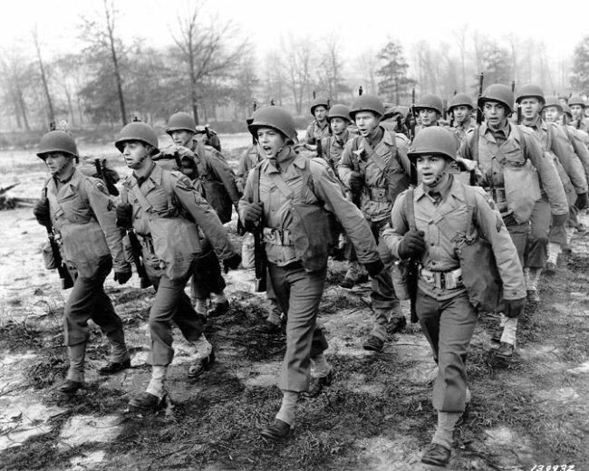
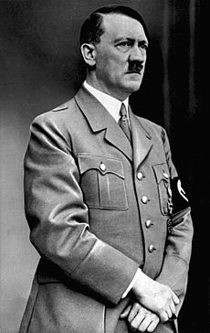
Men at War
By Navandeep

Slide 2
What were men allowed to eat and drink?
In the world war 2 they were allowed to eat and drink dried mustard, 2 eggs, milk, cheese , salt, pepper and fruit but they had to grow the fruit.
What guns did men use in the war?
Rifles
-De Lisle carbine
Enfield Pattern 14
Martini Enfield
M1917 Enfield
Submachine guns
Lee Enfield
-Lanchester
-Sten
-Thompson
L2A3 Sterling

Slide 3
Machine guns
Bren Light machine gun
Browning Automatic Rifle
Lewis gun
Vickers Gas
Vickers medium machine gun
Browning M1919
Browning M2
Machine gun
Vickers Berthier
Hand guns
Enfield MK Revolver
Webley Revolver
Browning FN-Inglis
Colt M1911A1
Webley
Welrod
Smith and Wesson model 10
Colt New Service
Colt Official Police

Slide 4
What did men wear?
In world war 2 men wore suits , hats , Trench coats and shoes but they had to be polished.
What did soldiers eat during the war?
- They ate c-rations when they ate the only had the time of 20 minutes also they weren’t allowed food like burgers and chips.

Slide 5
How many soldiers died?
- 264,000 Britain soldiers in world war 2.

