Slide 1
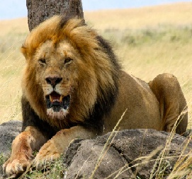
The fish swims a way as fast as a cheater,
Swim , swim, swim,
As colourful as a rainbow ,
I am the fish!
Everything lives,
Everything dances,
The nasty lion goes roar!
The pleasant fish goes hip!
The bad-temper gorilla goes thump!
The gorilla eyes are red beads staring at animals in the forest.
The growling gorilla is grumpy,
I am the gorilla ,
That is angry,
That is fearless,
That is bad –tempered!
The Animal Poem
The nasty lion goes roar!
The pleasant fish goes hip!
The bad-temper gorilla goes thump!
I leap to the left,
I roll to the right,
I am the lion , gleaming like gold.
That hunts through the plains,
That pounces,
That jumps,
That glares!
Everything lives,
Everything dances,
The nasty lion goes roar!
The pleasant fish goes hip!
The bad-temper gorilla goes thump!

