Slide 1
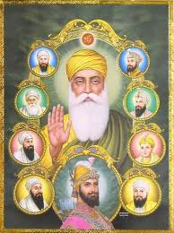
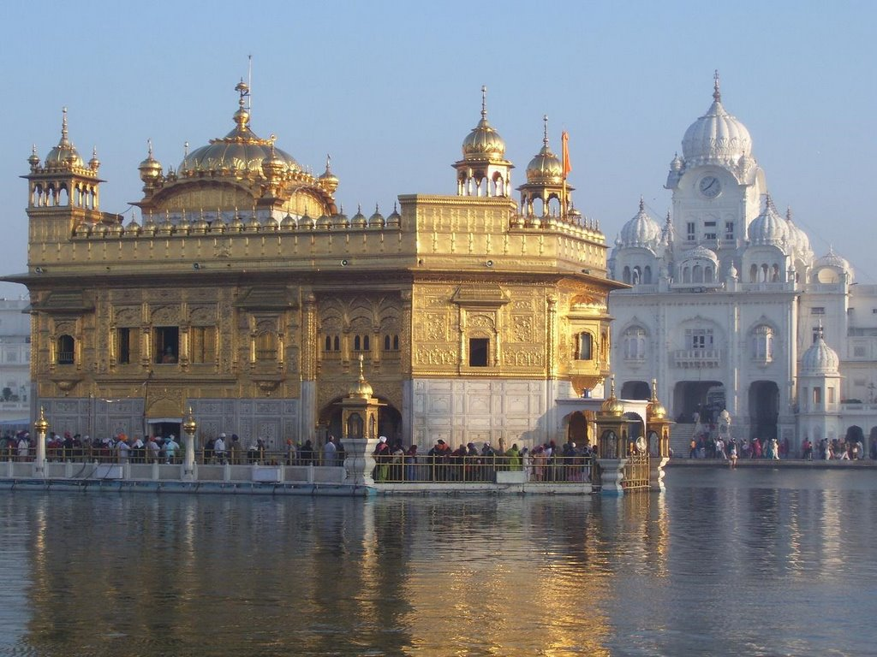
R.E
Why are religious leaders important?
By Navandeep Bassi 4P

Slide 2
Sikhism
There are about 20 million Sikhs in the world
They found the religion in the 1600’s
It was found by Guru Nanak in Pakistan and India
The title of the holy book is Guru Granth Sahib
They pray at the Gudhwara and at home
There are 11 Guru’s but, the last one is the holy book which has all the Guru’s speech in it
They believe in the 5K’s which lots of very religious people do in Sikhism, They are:

Slide 3
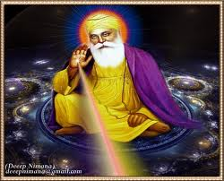
Guru Nanak Dev Ji
Guru Nanak was around from 1469-1539. But, he is still alive today.
He was the 1st person to find Sikhism
One of the reasons why he is important is because he showed everyone fairness and treated people nicely. This is why we eat at the Gudwara to show we are the same.
He was very brave and strong to find and make a religion.
He was very clever and mixed Islam and Hinduism to make a new religion.
The first Guru fought for what was right. He was very brave as he didn’t want to be in a Caste system where rich and poor were separated. Even today they still have it! He made an impact on some people by stopping to follow the Caste system
He was very religious because for 30 years he went on lots of trips to help him find religions and different beliefs in the world.

Slide 4
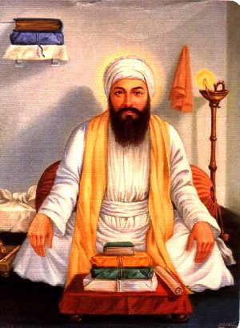
Guru Angad Dev Ji
This Guru was around from 1539 to 1552
He was born a Hindu ,and at a young age he started following Guru Nanak.
He really wanted to meet him and when he did for 7 years he meditated
After Guru Nanak he carried On Sikhism
He put lots of stuff in the holy book and made the alphabet easier and named it Gurmukhi.
He was very caring and gave everyone chances. When he made the new alphabet he taught lots of young children the language
And made new schools for them. It gave children an education which shows he was nice. He made lots of children clever and was very clever as well.
There were lots of religions but, no one liked Sikhism but, the Guru was very strong and made people think it was a nice religion.
The caste system was still carrying on but, the guru didn’t like it so had langar which is good at the temple to show everyone is the same by eating the same food even if you are rich or poor.

Slide 5
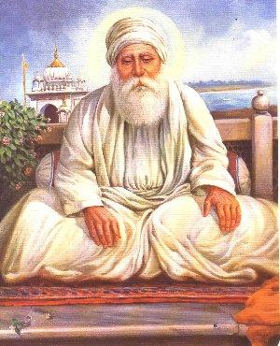
Guru Amar Das Ji
He was born in 1479 but, became a Guru in 1552. He finished in 1574
He was a very religious Hindu who went on many religion trips.
He overheard his neighbours songs and found them very relaxing. They were the first Guru’s and wanted to go to Guru Angad Dev Ji , at the age of 60 but, didn’t want to make a fight between him and the next Guru .
He was the next Guru and tried to get rid of Caste systems
He started to make more people understand Sikhism.
He did this by trying to make people know more about the Caste System
He made lots of places for Guru Nanak and made more people know about Sikhism all around the world.
He then passed the Guruship onto his son who was known as Guru Ram Das Ji

Slide 6
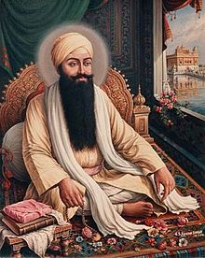
Guru Ram Das Ji
This Guru was the forth and was around from the time of 1574 to 1581
He was born in Lahore and his family were very honest. He then made this one of his many teachings and showed people to live a good life
He and the Guru before used to go on religious journeys together.
His parents died when he was seven and lived with his grandmother
He told people not to believe in superstitions. These are beliefs that doing stuff will bring you bad luck. E.g. opening a umbrella inside.
He also taught people that religion trips were pointless. He thought you could pray anywhere in the world.
He followed all the other Guru’s and made an impact on lots of people by showing them that the Caste system is not nice and stupid
He taught and believed that everyone should be treated the same and doesn’t matter about their skin, face, country or Caste. Everyone was treated the same.
He found a place in India which is now known as Amritsar and has a very famous Gudwhara their known as the Golden Temple

Slide 7
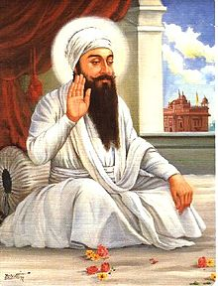
Guru Arjan Dev Ji
He was around in the time of 1563 to 1606
He was very nice and had a lot of concentration. He would do anything for anyone!
This Guru was the person who made the Golden temple and is known as the Harminder Sahib.
He was a very caring man and made lots of people donate a bit of their money for charity which would help people and make stuff.
He was very peaceful and made a lot of religious poems and text to meditate to and listen to
This Guru was very clever and artistic. He made lots of really nice and beautiful places but, Didn’t spend too much and made them simple. They looked astonishing but, he made them quite simple. It was mostly Gudwara’s and decorated them because it showed respect to God.
He was very respectful and treated everyone the same whoever they were because he didn’t want people to treat him horribly.
This Guru was very strong and nice. He died when the Muslim Emperor hurt him for five days to try and stop Sikhism and change part of the holy text to something else. He was so nice and sacrificed his life for his religion and passed on his son to be the next Guru.

Slide 8
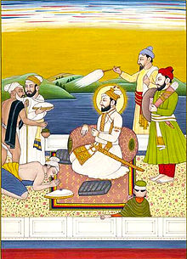
Guru Hargobind Ji
He lived from 1595 to 1644
There was an emperor who used to kidnap Sikhs and he told the Guru that as many strings you have on your coat is how many prisoners you can get out. There 52 prisoners and 52 strings on his coat which means they all got out. This shows that they are magical because he had the exactly the right amount of string s on his coat which was a miracle
This Guru was very kind and strong .He taught people how to fight because he cared about their health. It was for protecting them in case they were ever attacked or kidnapped from the emperor.
This Guru was a very courageous person because he defeated the Muslim Emperor but, didn’t do it by fighting and violence. He risked his life for every Sikh in the world .
He was very encouraging. He brought everyone of us smiles even if it was a very sad time. He did this by helping everyone with self defence and inviting them to pray with him at the Gudwara.
He was very religious and had 2 swords. One was for god, one was for power. This showed that he fighted for what he thought was correct.

Slide 9
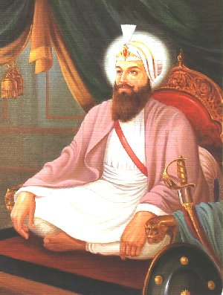
On
Guru Har Rai Ji
He use to pray to God a lot but, he did still carry on the Sikh which the Guru before created.
He was also a very clever person and made a hospital where people could make a lot of medicine to help people feel better if they were feeling ill. It also shows he cared because he made it so people would feel better
The Guru respected everyone and was very helpful for everyone. He helped anyone even if they were mean to him! The emperors son was really sick and was going to die. They were very mean to him the Guru still helped him and was so magical that he healed him. H e was about to die but, he was suddenly fine and a healthy person
He was a very religious man and was strict. He followed the rules and set examples for people. One day a man changed some of the words in the holy book which guru Nanak had started off. He changed one word but the Guru thought it wasn’t respectful and was no longer able to have such access to the original holy book.

Slide 10
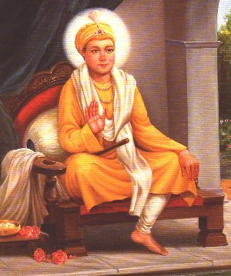
Guru Harkrishan Ji
He was around 1656 to 1664
He was a very sensible person and whilst his father was dying he told him not to be dragged in with the fancy life and always stay with Sikhism. He did this and followed his father throughout his life.
This Guru was a very magical one. He went on a lot of religious trips so he could pray and be peaceful . On many of his trips he was very
Caring. On the way he saw a lot of sick people which could be cured and were very close to being dead. He was so magical that he cured them so quick and made them into healthy people
The Guru made a big impact on everyone and helped people understand what Sikhism actually was and helped them pray to god. He taught people not to ask for too much and be caring. He showed people you could have a happy life even if you do not have all the money and stuff.
The Guru was a very loyal man. The emperor tired to trick him by putting beautiful princesses in front of him and one slave. But he stood by what he thought and said she was a princess. This means that he taught everyone fairly whoever they were in the world.

Slide 11
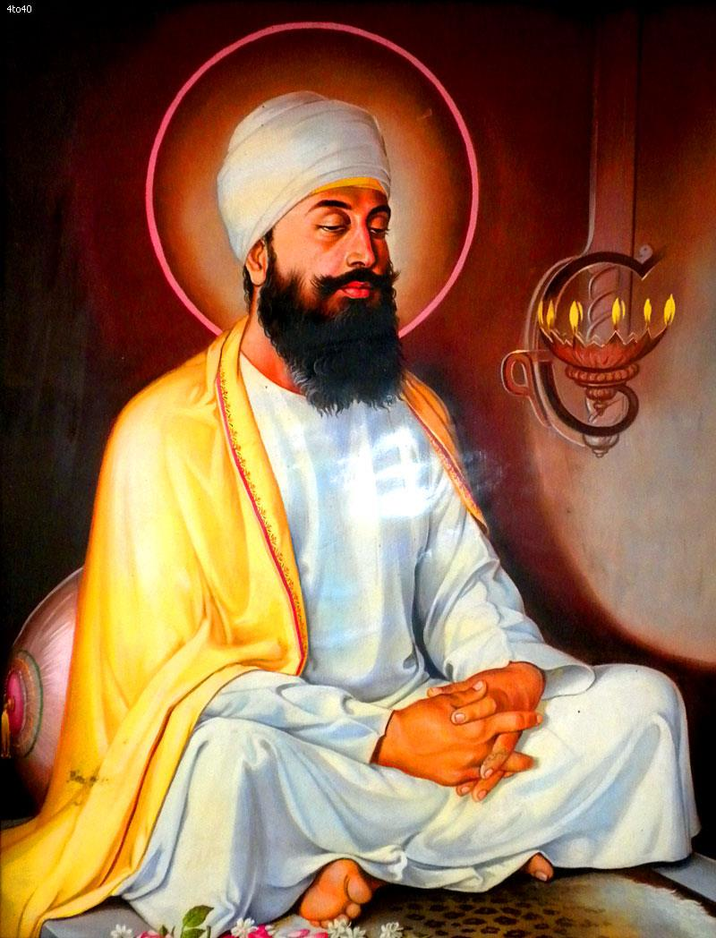
Guru Tegh Bahadar Ji
He was the youngest son of Guru Hargobind Ji.
he had such a brilliant life and came from a rich family he wanted to give all of that up to be a Guru
He was so caring that he died for other people. The emperor problem was still carrying on and the desperate Hindu's came to him because they were trying to destroy it. He then chose to help them and he had to either die or become a Muslim. He said he rather have died than not being able to follow Sikhism so he died for the religion of Sikhism.
The Guru did a lot of sports such as archery or horse riding. He was very good at the sports.
The Guru was a vey creative and smart person. He wrote a lot of poetry to do with Sikhism and lots of his poetry was so great it is in the Holy book for Sikhs to read!
The Guru was very respectful especially to his father. When he was a young boy his dad wanted him to get married. He found a girl and without being forced to he said he wanted to marry the girl because his father said so.
They made everyone be treated the same and made an impact on people by helping them stand up to the evil emperor. They were fair to all the people in the world and everyone was treated in the same way

Slide 12
Guru Gobind Singh Ji
He lived form 1666 to 1708
He was the son of Guru Teghbahadur and became a guru when he was the same age as me!
He was very clever and was smart in lots of different subjects and went to a good school
He used to do army training and made the same impact on others by making it known. But he made it to show he would defend Sikhism if they were being hurt.
He was the last human Guru.
The previous Guru’s all showed sacrifice and respect. This is what he was given by other people. He asked for 5 people who would die for him and 5 men came up
He took them into a tent and the crowd heard swords. They saw blood on his sword but, it was a trick. Later on 5 men came out who were really nicely dressed and this was called the Khalsa he put gods love on them and they were role models
This Guru was very powerful. The five K’s were what the Khalsa people had and to be very religious you needed these. He made a big impact on people by getting lots of people to follow him and following the 5k’s
The man was very intelligent and decided the next Guru was going to be a book which would live forever. All the Sikhs were happy with this and treated it with the amount of respect people would get

Slide 13
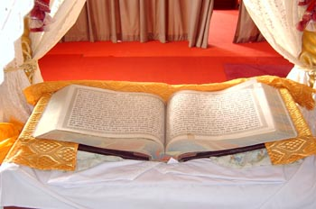
Guru Granth Sahib Ji
This is the 11th guru and is still around today and will never go
All of the Guru’s teachings are in this book . The main thing is to teach everyone equal.
It isn’t just about the Guru’s and there was more people from other religions who were in it.
It is written in Punjabi and in the language made by a guru called Gurmukhi
This text is just like a god and has to be treated with a lot of care if your using it. You have to first wash your hands, you can’t have your shoes on and you have to cover your head in something to show respect.
You have to put it correctly. And is placed somewhere really high so it is safe and no accidents happen

Slide 14
Why are religious leaders important?
As you can see there are lots of reasons for why religious leaders are important. Without them we could maybe not be here and maybe there would still be lots of bad people in the world like the emperor. We would not be able to do anything we want.
People would still be mean to you because you were a Sikh and you could maybe be killed because of that. If religious leaders weren’t here people would not be smart, happy, respected, courageous, honest loyal and strong. Life would be very terrible and lots of people would die because everyone would be scarred to say something to them back.
Our life would be very sad and scary. They are very important because if they were not there we would not be able to say what we thought about the things that were going around in the world.
Even we wouldn’t be able to win even if we’re strong! It is because god has power which can help him win and he can only defeat thousands of lots of people.
I think that religious leaders are really important because they make the world a safe and happy place for us all to live in. Without them life would not be the same at all.

