Slide 1
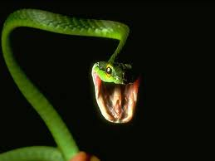
The song of the animal world
The reckless lion goes roar!
The deadly snake goes hiss!
The infuriated gorilla goes thump!
I leap to the left ,
I roll to the right,
I am the lion
that is like water shining on a hot day.
I am the lion that hunts through the day,
that roars, that glares, that pounces.

