Slide 1
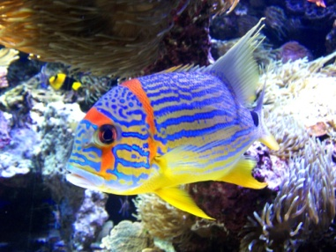
The lion goes roar!
The fish goes hip!
The snake goes hissssssss!
I pounce to the left ,
I leap to the right,
I am the lion that’s shiny as the boiling sun,
That hunts through daylight ,
With the sun gleaming on my shaggy hair.
I am the lion that hunts you !
I blow bubbles in the sea then I flip like a pancake,
I start to the left I swim to the right,
I am the stripy fish,
That swims deep under the light blue ocean .
I hisssssss,
I slither ,
I don’t have legs,
I shed my skin,
I live in the wild ,
I am the snake ,
That is an athletic snake .

